Slide 1

Act Locally, Impact Globally

Slide 2
Lecture 6: Data Wrangling

Slide 3
Data Wrangling
Data wrangling, sometimes referred to as data munging
The process of transforming and mapping data from one "raw" data form into another format.
Objective:
To make it more appropriate and valuable for a variety of downstream purposes such as statistical analysis and ML based analytics.

Slide 4
Data Wrangling
All the steps involved from loading data into Pandas to make it fit for a given Machine Learning Model are a part of Data Wrangling.
It includes :
1. Load, explore and analyse your data
2. Drop the unnecessary columns like columns containing IDs, Names etc.
3. Drop the columns which contain a lot of null or missing values
4. Impute missing values
5. Replace invalid values
6. Remove outliers
8. Transform categorical variables to numeric codes( Encoding)
10. Binning the continuous numeric variables ( Discretization)
11. Normalization

Slide 5
Normalization
Normalization is a method used to normalize the range of independent variables or features of data.
Also known as Feature Scaling

Slide 6
Normalization
Motivation
Since the range of values of raw data varies widely, in some machine learning algorithms, objective functions will not work properly without normalization.
For example, many classifiers calculate the distance between two points by the Euclidean distance.
If one of the features has a broad range of values, the distance will be governed by this particular feature.
Therefore, the range of all features should be normalized so that each feature contributes approximately proportionately to the final distance.

Slide 7
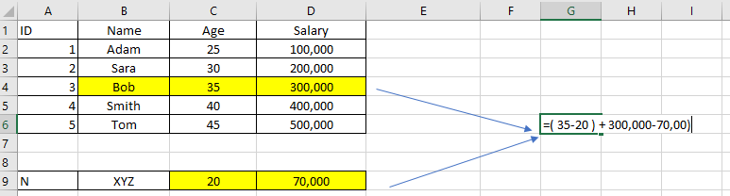

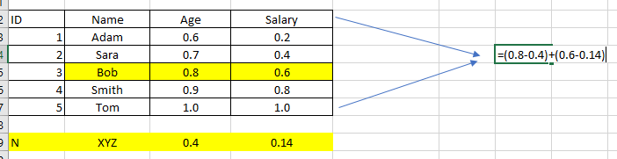

Why Normalization ?
Objective function is governed by the variable with high range
Normalization brings all variables to the same range

Slide 8
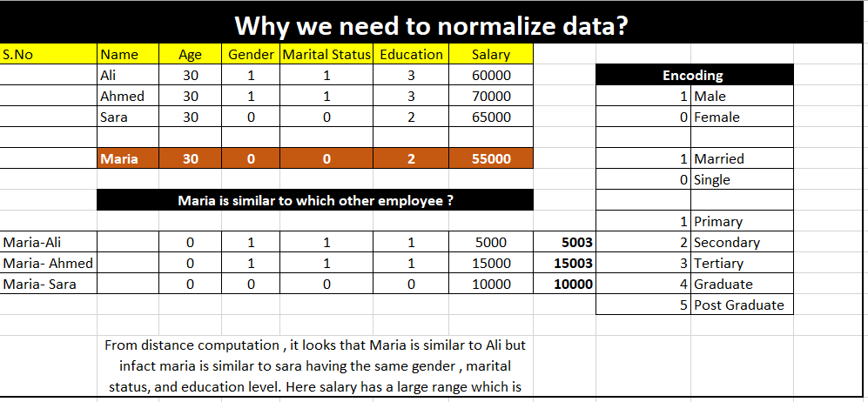
Why Normalization ?

Slide 9
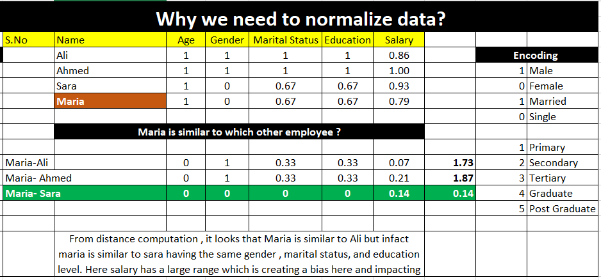

Slide 11
Normalization Techniques
Z-Score Normalization
min_max Normalization
Decimal Scaling

Slide 12
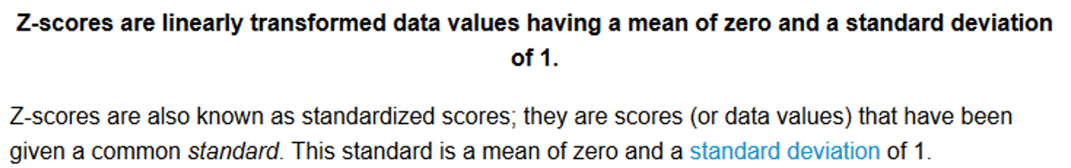
Z-Score Normalization

Slide 13
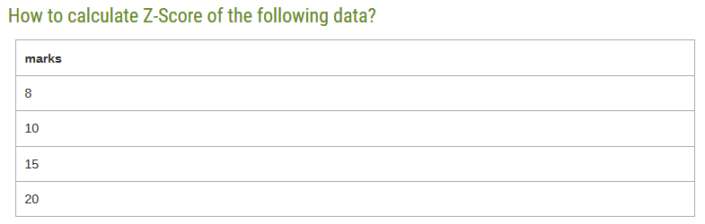
Z Score Normalization – Example

Slide 14
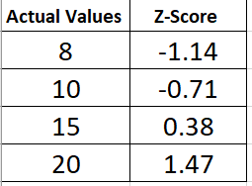

Z Score Normalization

Slide 15
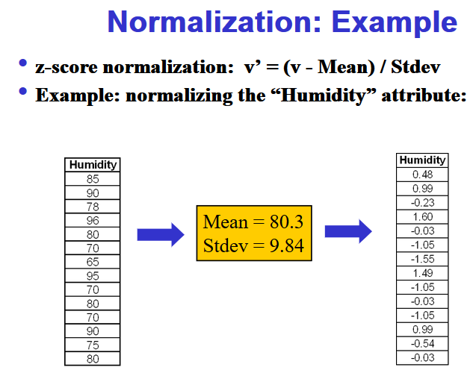
Z-Score Normalization

Slide 16
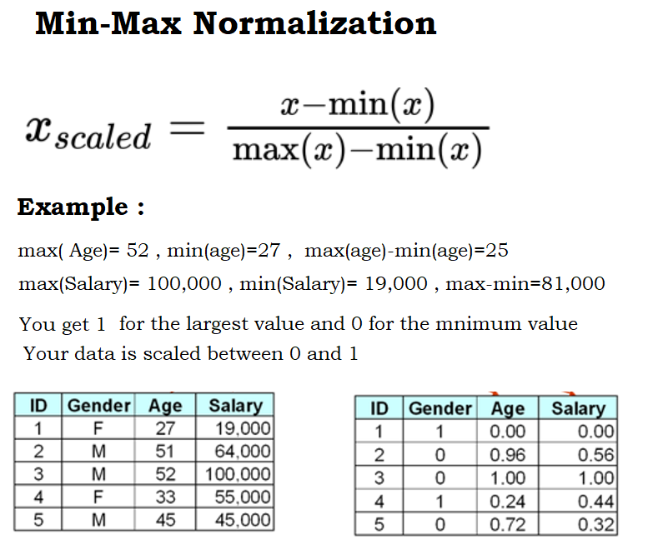
Min-Max Normalization
Notes:
Min-Max Normalization is sensitive to outliers . The normalized range will be [0.1]

Slide 17
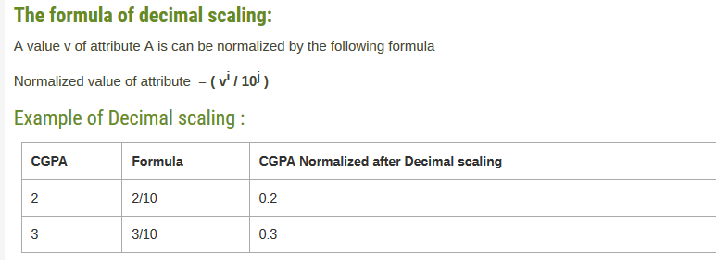
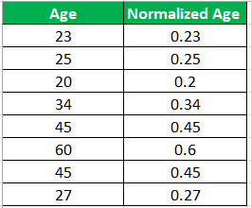
Decimal Scaling
Notes:
The normalized data range will be [-1,1] . This techniques is also sensitive to outliers .

Slide 18
Normalization Summary
Technique | Normalized Range | Outlier Sensitivity | Uniform Range
Min-Max | [0,1] | Yes | Yes
Z-Score | Varies | No | No
Decimal | [-1,1] | Yes | Yes

Slide 19
Feature Discretization

Slide 20
Feature Discretization
In statistics and machine learning, discretization refers to the process of converting or partitioning continuous attributes, features or variables to discretized or nominal attributes/features/variables/intervals

Slide 21
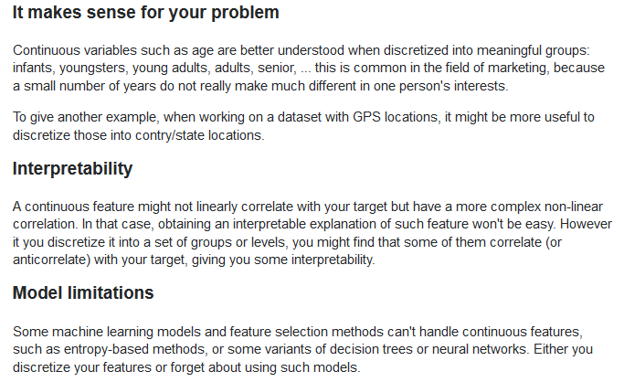
Why Discretization ?

Slide 22
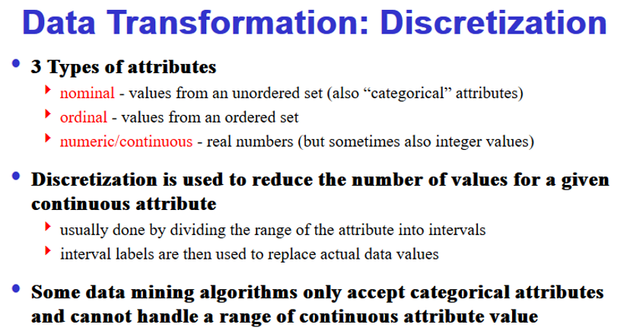
Data Discretization

Slide 23
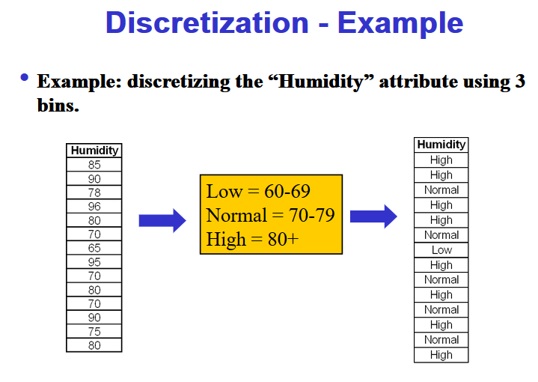
Discretization

Slide 24
Feature Encoding

Slide 25
Feature Encoding
Some Machine Learning algorithms like Neural Networks , KNNs , Decision Trees and Random Forest cannot directly work with categorical data.
So we need to transform categorical string data in the form of numeric codes
This encoding of string categories into numeric codes is called Feature Encoding.

Slide 26
Feature Encoding
Manual Encoding (Ordinal Attributes)
We manually assign codes
Label Encoding ( Works well with nominal attributes)
Codes are automatically assigned by a LabelEncoder() function
One-Hot Encoding ( Works well for both Ordinal and nominal attributes)
For each attributes value , a column is added to the dataset.

Slide 27
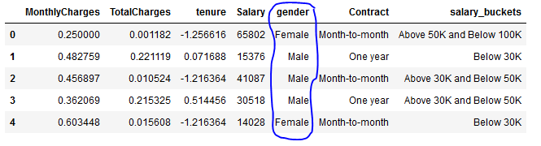
Manual Encoding

Slide 28
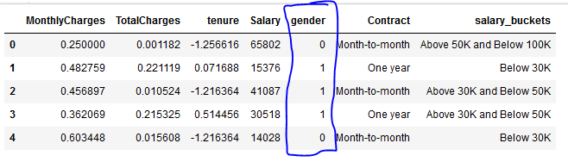
Manual Encoding

Slide 29
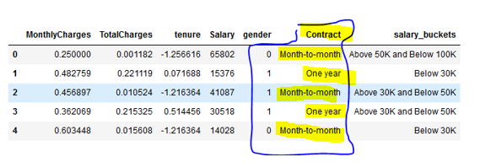
Label Encoding

Slide 30
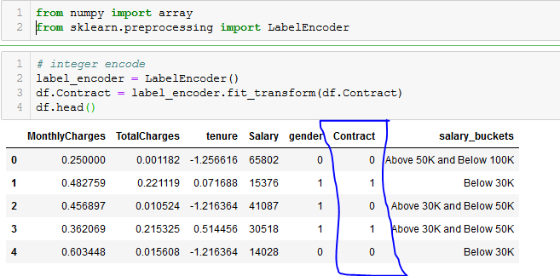
Label Encoding

Slide 31
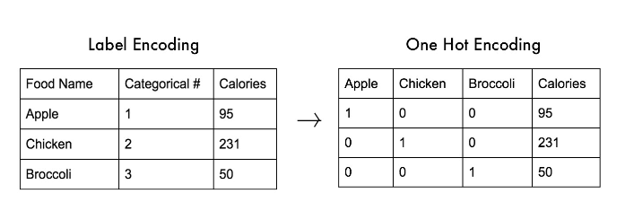
One Hot Encoding

Slide 32
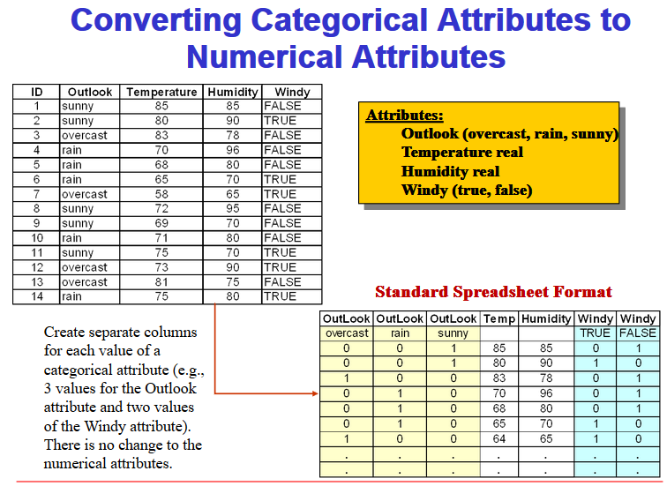
Feature Encoding

Slide 33
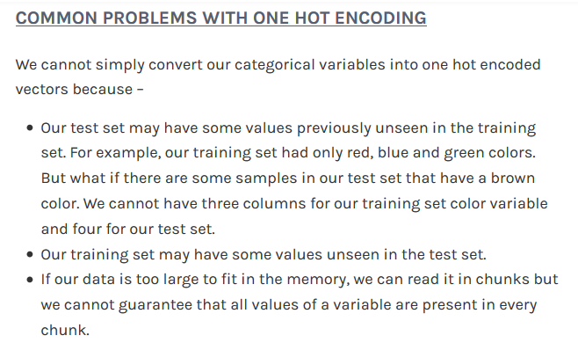
One-hot Encoding

Slide 34
Summary
Why Normalization ?
Normalization Methods
Discretization
What is the benefit to discretize data?
Feature Encoding
Why Feature Encoding?
Feature Encoding Techniques

Slide 35
Hands On :

